Slide 1
Azure Site Recovery - ASR
Peter De Tender
Program Manager, AzureCAT GSI | pedete@microsoft.com | @pdtit
Notes:
Suggested introduction:
Faced with _______
We did _______
And discovered_______

Slide 2
Objectives
In this session, I will cover:
Why Disaster Recovery matters to your customers
What is Disaster Recovery, and what solutions are there?
Azure Site Recovery for complex workloads infrastructure – in-depth
Demos and Q&A
Notes:
Title: Objectives
Length: 2 minutes
Participant Notes:
After completing this module, you will be able to:
Disaster Recovery features available in Azure
Integrating Azure Disaster Recovery features in an SAP infrastructure
Azure Site Recovery
Azure Site Recovery for SAP VM infrastructure
Make sure you address what this course will NOT cover based on experience.
Start Time xx:xx / Length: 2 minutes
Review the learning objectives.

Slide 3
Why Disaster Recovery Matters
Notes:
Azure Virtual Machines lets you create and use virtual machines in the cloud. This is one of Azure’s Infrastructure as a Service (IaaS) features. The A virtual machine technology can be used in variety of ways.

Slide 4
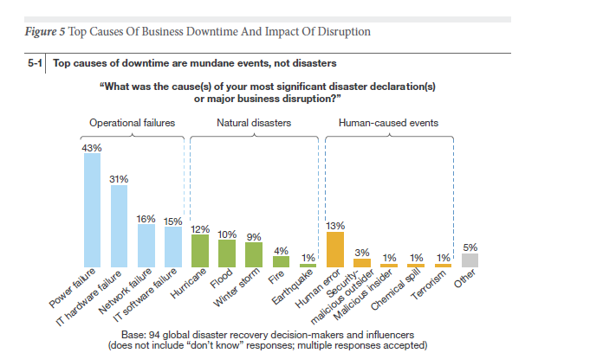
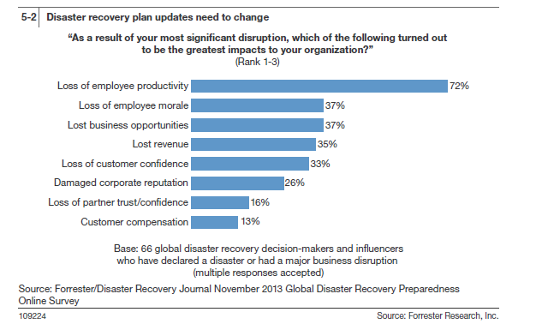
Most common cause for DR is not natural disasters & Impact is severe

Slide 5
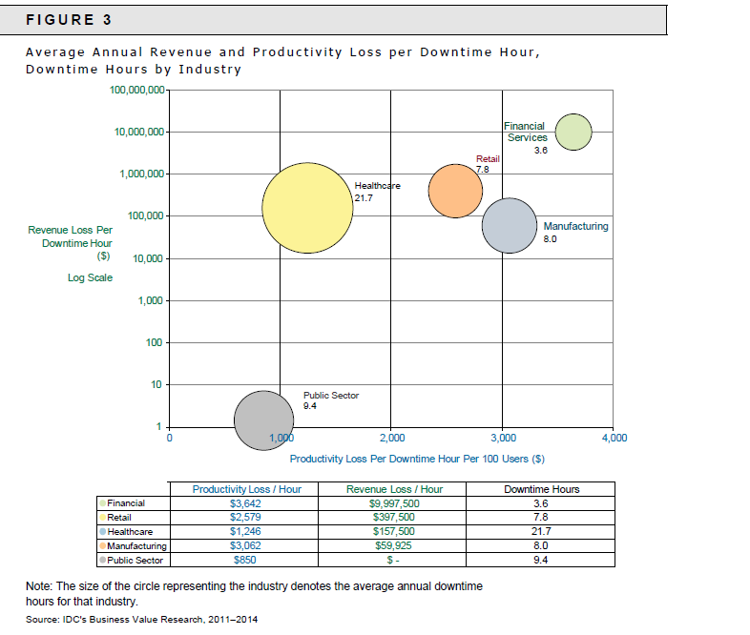
Every hour we save in RTO has direct ROI

Slide 6
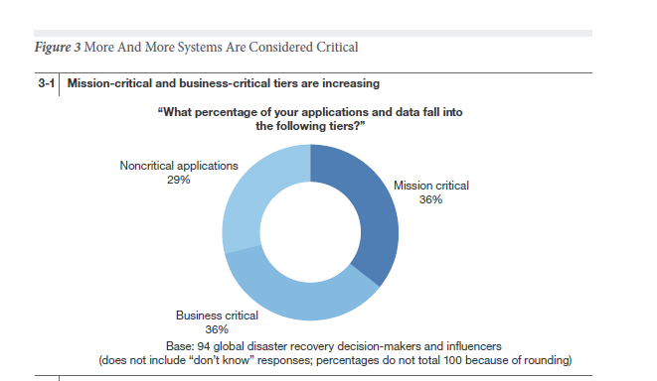
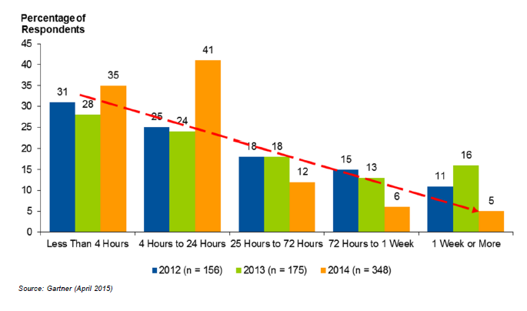
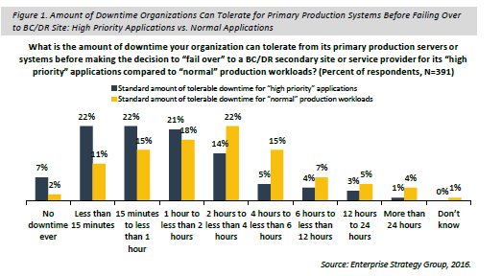
70-80% Workloads need DR and they can‘t get the desired RTO using offsite backup
3 out of 4 companies are at risk, failing to prepare for Disaster Recovery. Source: DR Preparedness Annual report, 2014
Source: Forrester, 2013

Slide 7
Availability
Backup is all about Data Availability
Value Prop – Restore data
Solution – Azure Backup
Hero Scenarios
Oops Delete
Long term retention
Disaster Recovery is all about Application Availability
Value Prop – Recover Application
Solution – Azure Site Recovery
Hero Scenarios
Disaster Recovery
Migration

Slide 8
What is Disaster Recovery?
Notes:
Azure Virtual Machines lets you create and use virtual machines in the cloud. This is one of Azure’s Infrastructure as a Service (IaaS) features. The A virtual machine technology can be used in variety of ways.

Slide 9
“Familiar” DR Solutions
Storage replication
Stretch cluster using single vLAN with single address space
Active / passive
Dynamic incoming connection failover
Geo-Load Balancing
Stretch cluster
–
Single vLAN
Compute nodes
Compute nodes
Effective, although expensive to deploy and maintain
Normally tied to hardware vendor specific technologies
Difficult to perform partial failovers
SAN replication
Fault tolerant data storage
Fault tolerant data storage
DataCenter 1
DataCenter 2

Slide 10






The D/R challenge
External DR solution
Your on-premises IT platform

Slide 11
Reasons to reconsider your D/R today
Historically challenging
Complicated solutions
Required end-to-end planning and design
Vendor lock-in
Hard to test
In most cases “pretty” expensive
Commodity solutions are now in the market
Public cloud offerings like Azure ☺
OPEX vs. CAPEX for your D/R = it’s way cheaper!!!!

Slide 12


Microsoft D/R solutions
Integration of WSB/DPM with Microsoft Azure Backup
5
Microsoft Azure
Orchestrated Physical, Hyper-V & VMware VM Replication & Recovery using Azure Site Recovery, between on-premises locations, or between on-premises & Microsoft Azure
}
6
2
Hyper-V Guest Clustering for app- level HA, i.e. SQL Server AlwaysOn FCI
Centralized backup with Data Protection Manager
4
1
Hyper-V Failover Clustering for VM Resilience
Simplified protection with Windows Server Backup
3

Slide 13
Azure Disaster Recovery Components
Notes:
Azure Virtual Machines lets you create and use virtual machines in the cloud. This is one of Azure’s Infrastructure as a Service (IaaS) features. The A virtual machine technology can be used in variety of ways.

Slide 14
Azure D/R Components
Traffic Mgr / App Gateway / Load Balancer
Premium Storage for DB VMs
CDN, Redis DB Cache,…
SQL Geo-Replication
Virtual Machine Availability Sets
Azure Site Recovery (ASR)

Slide 15




SQL Server Availability Replica on Azure
Azure VNET
SQL DB Sec. Replica WSFC node 3
WSFC SQL AG Listener
Site-to-site or Express Route
DR SQL DB Sec. Replica
Sync
Commit
Asynchronous commit
SQL DB Prim. Replica WSFC node 1
SQL DB Sec. Replica WSFC node 2
Cluster FSW

Slide 16

Availability Sets
Recommended for workloads with 2+ VM’s
Azure has knowledge of your server topology – won’t shut down all instances during host upgrades.
Provides physical redundancy at the server, power, and network level
Required to achieve 99.95% SLA
Fault Domain
Fault Domain
Server Rack
Server Rack
Availability Set
Availability Set

Slide 17
Azure Site Recovery - ASR
Notes:
Azure Virtual Machines lets you create and use virtual machines in the cloud. This is one of Azure’s Infrastructure as a Service (IaaS) features. The A virtual machine technology can be used in variety of ways.

Slide 18

Azure Site Recovery One solution for multiple infrastructures
Replication
Replication
SAN
SAN
Replication
Microsoft Azure
Hyper-V
Hyper-V
Hyper-V
Hyper-V
Hyper-V
1
Hyper-V to Hyper-V (on-premises)
2
Hyper-V to Hyper-V (on-premises)
3
Hyper-V to Microsoft Azure
Replication
Replication
Microsoft Azure
VMware or Physical
VMware
VMware or Physical
4
VMware or Physical to VMware (on-premises)
5
VMware or Physical to Microsoft Azure

Slide 19
Azure Site Recovery One solution for multiple infrastructures
Replication
Replication
SAN
SAN
Replication
Microsoft Azure
Hyper-V
Hyper-V
Hyper-V
Hyper-V
Hyper-V
1
Hyper-V to Hyper-V (on-premises)
2
Hyper-V to Hyper-V (on-premises)
3
Hyper-V or SCVMM to Microsoft Azure
Replication
Replication
Microsoft Azure
VMware or Physical
VMware
VMware or Physical
4
VMware or Physical to VMware (on-premises)
5
VMware or Physical or AWS to Microsoft Azure
(*) In the on-premises scenarios, ASR is the Orchestrator only. No data travels to/from Azure cloud platform.

Slide 20
Azure Site Recovery as MIGRATION Tool One solution for multiple infrastructures
Replication
Replication
SAN
SAN
One Time Replication
Microsoft Azure
Hyper-V
Hyper-V
Hyper-V
Hyper-V
Hyper-V
1
Hyper-V to Hyper-V (on-premises)
2
Hyper-V to Hyper-V (on-premises)
3
Hyper-V or SCVMM to Microsoft Azure
Replication
One Time Replication
Microsoft Azure
VMware or Physical
VMware
VMware or Physical
4
VMware or Physical to VMware (on-premises)
5
VMware or Physical or AWS to Microsoft Azure
(*) In the on-premises scenarios, ASR is the Orchestrator only. No data travels to/from Azure cloud platform.

Slide 21


Azure Site Recovery: The Complete Disaster Recovery Solution
OMS
Part of a Broader Cost Effective Management Story
Any Cloud
VMware, HYPER-V, Physical, AWS, AzClassic
DR to Azure
DR to Alternate Site
+
Any OS
Windows
Linux
App Aware
SharePoint | SQL Server | Exchange | SAP | Oracle | and more..
Cloud On-Ramp
Disaster Recovery | Migration| Dev/Test
Power of Azure
Hyper-Scale| Enterprise Grade | Hybrid | Agile

Slide 22

ASR Hero Scenario – Typical 3 Tier Web App
Azure Site Recovery
DR Orchestration
DR Orchestration
SQL Backend
ASR Replication
Azure Storage
App Front End
App Tier
ASR Replication
Active Directory
ASR Replication
Primary Site
Azure
Above shows DR to Azure however same Hero scenario is applicable for On Premise to On Premise DR.

Slide 23
ASR Hero Scenario - with AD Replication and SQL Availability Group
Azure Site Recovery
DR Orchestration
DR Orchestration
SQL Backend
IaaS VM
SQL Availability Group
App Tier
App Front End
ASR Replication
Azure Storage
Active Directory
AD & ASR Replication
IaaS VM
S2S VPN
Azure
Primary Site

Slide 24
ASR Configuration Walkthrough
Notes:
Azure Virtual Machines lets you create and use virtual machines in the cloud. This is one of Azure’s Infrastructure as a Service (IaaS) features. The A virtual machine technology can be used in variety of ways.

Slide 25
Firewall Rules
All ASR scenarios require access to following URLs
*.hypervrecoverymanager.windowsazure.com
*.accesscontrol.windows.net
*.backup.windowsazure.com
*.blob.core.windows.net
*.store.core.windows.net
All communication happens on https (443)
IP address based firewall rules can be created by opening up Azure Datacenter IP Ranges for the region of recovery services vault and for WUS
IP range can change therefore it is not recommended to use IP based firewall rules
ntp://pool.ntp.org (default port 123, optional)

Slide 26
ASR for Hyper-V workloads
Configuration Step | Description
1. Configure ASR Vault | Create the ASR Security Vault configuration + download Vault registration Key
2. Prepare on-premises infrastructure | Download and install ASR Provider on Hyper-V/SCVMM/VMware infra
3. Create Azure Storage Account | Create Azure Storage Account for ASR
4. Configure Cloud Protection | Set up protection for the SCVMM/HyperV cloud
5. Map Networks | Map on-premises network to Azure VNets
6. Enable Protection for VMs | Create ASR protection group + enable protection for VMs
7. Configure Recovery Plans | Configure Recovery Plans with detailed steps (scripts / automation)
8. Perform Test Failover | Run a test failover to verify Recovery Plans are complete
9. Perform DR simulation | Run through a full DR simulation (planned / unplanned failover)
10. Update DR documentation | Update DR documentation with observations

Slide 27
ASR for Hyper-V environments
Notes:
Open SSMS
Generate a credential for SQL Server to use to access blob storage
Backup database
Select URL
Select the credential
Set storage account and container
Show the back up in blob storage.

Slide 28
Step 1: Create Recovery Vault
Create Azure Recovery Services Vault
Configure Site Recovery Vault
Specify Source and Target environments
Quick Start Wizard
Azure PowerShell “New-AzureRMSiteRecovery…”

Slide 29
Step 2: Create a Hyper-V Site
Create a Hyper-V Site to group one or more Hyper-V servers belonging to the same physical location (eg. New York Site)
A Hyper-V Server can only belong to 1 Hyper-V Site

Slide 30
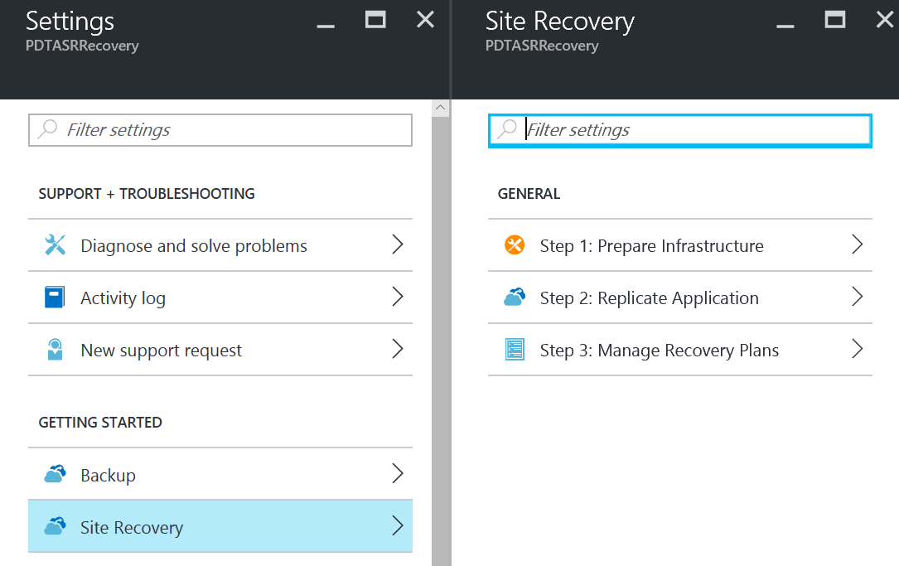
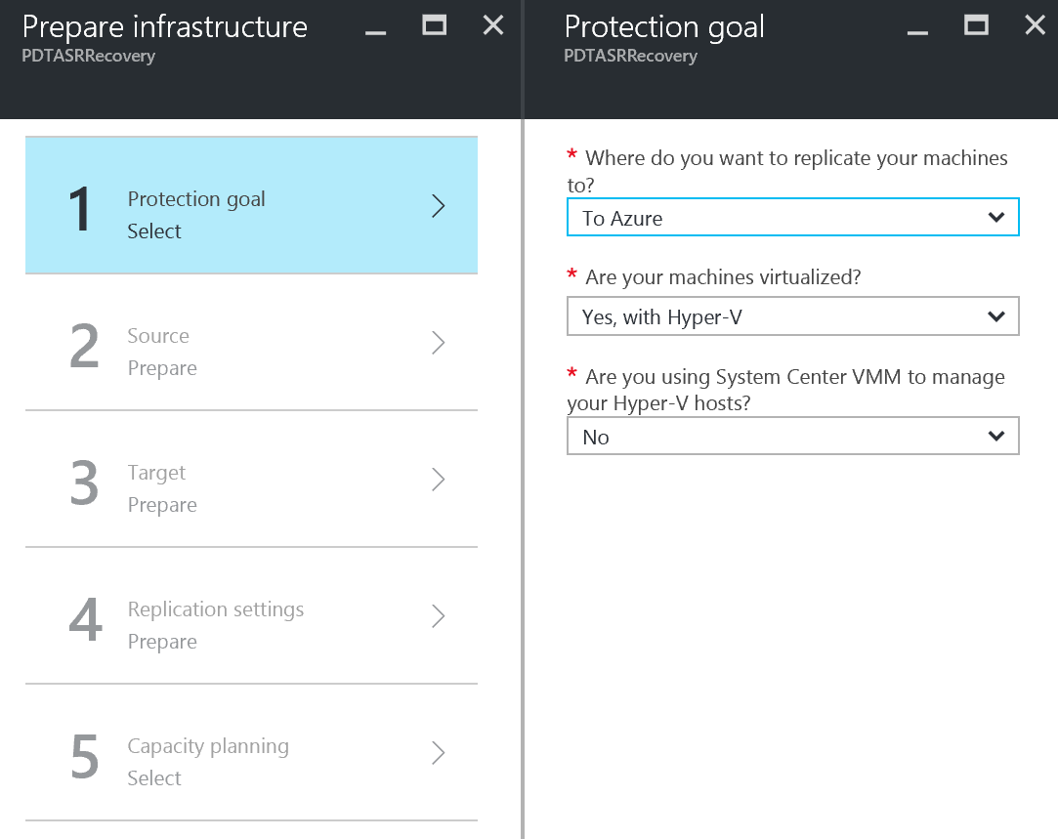
Step 2: Create a Hyper-V Site

Slide 31
Step 3: Prepare Hyper-V Servers
Download & Install a “Registration Key”
Download & Install the Azure Site Recovery Provider
The Registration Key links the Hyper-V Server to the Azure Hyper-V Site
Install both on each server you want to group to the same Hyper-V Site
If Hyper-V cluster nodes, install on all nodes

Slide 32
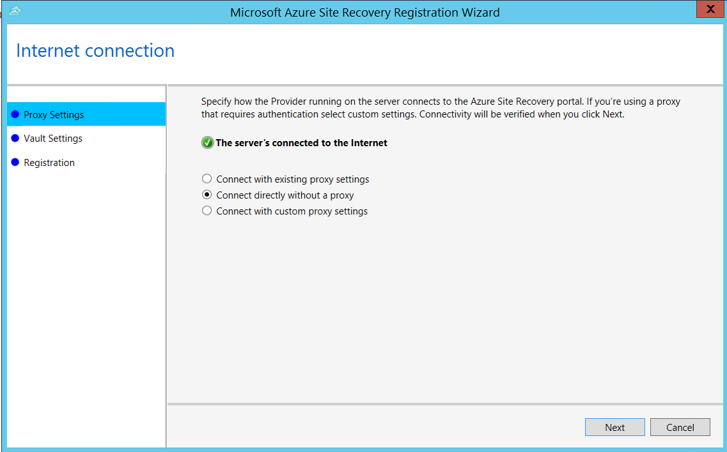
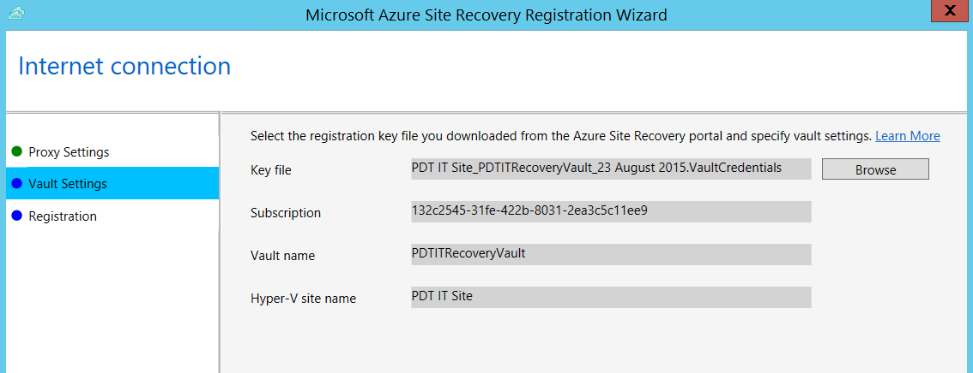
Step 3: Prepare Hyper-V Servers

Slide 33
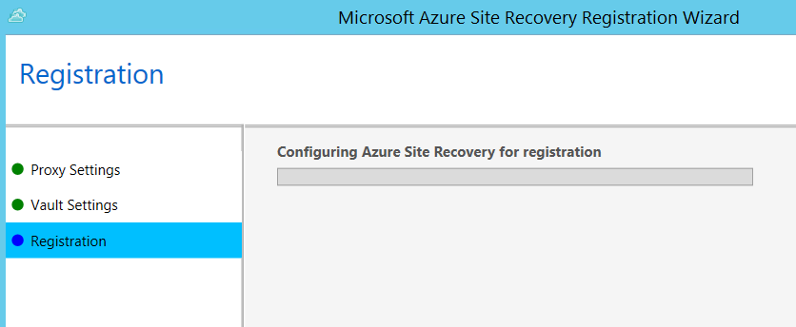
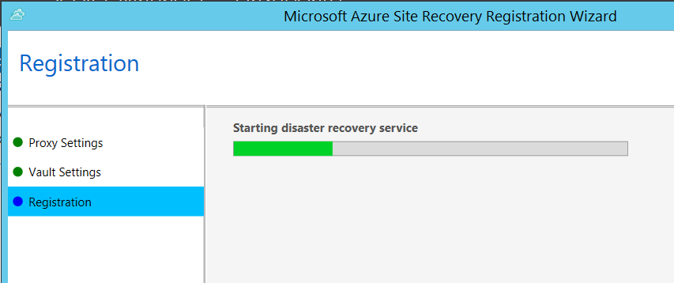
Step 3: Prepare Hyper-V Servers

Slide 34


Step 4: Prepare Resources
Create Storage Account
Unique Name *.core.windows.net
Location / Affinity Group
Geo-Redundant
Create Azure Virtual Network
Unique Name
IP-subnet (class A,B,C) + number of VMs
Location

Slide 35
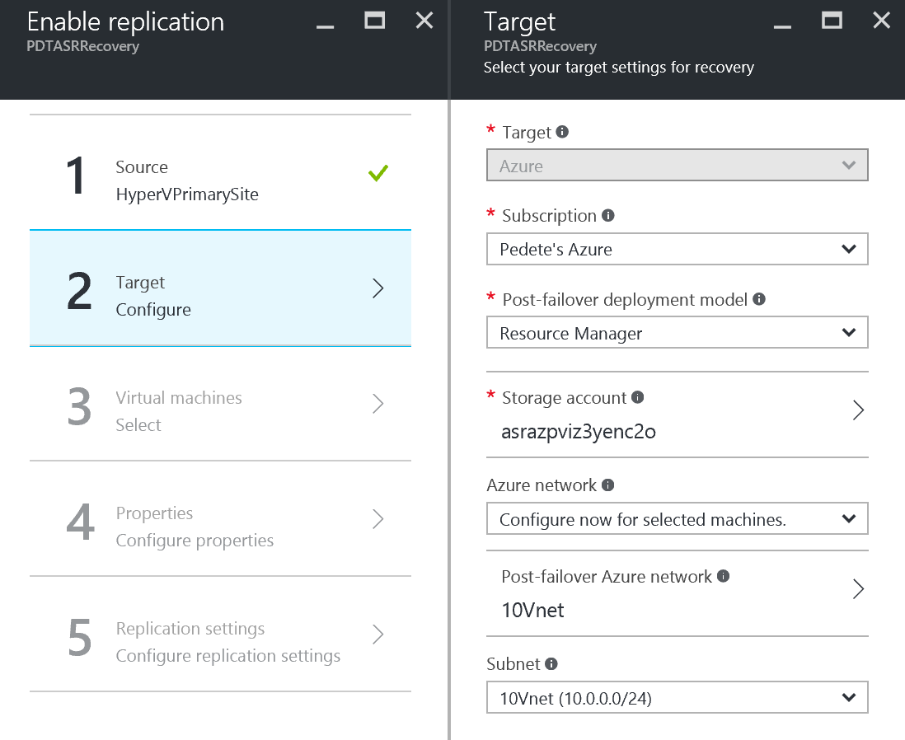
Step 4: Prepare Resources

Slide 36
Step 5: Enable Replication
Define common protection requirements:
Select VMs to recover
Copy Frequency
Recovery Point settings
Frequency of snapshots
Initial replication start time

Slide 37
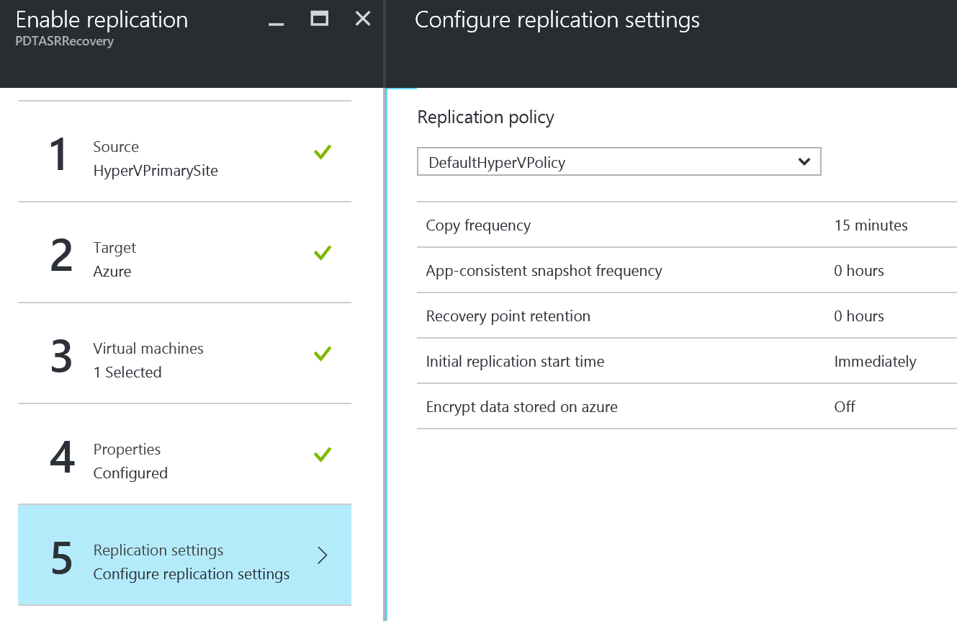
Step 5: Protection Groups

Slide 38
Step 6: Enable protection for VMs
Add Virtual Machines to the configured protection groups
Select Virtual Machine(s)
Specify Operating System
A VM can only be member of 1 protection group
Based on Protection Group Replication Start Time setting, VMs could get replicated immediately, consuming lots of bandwidth, taking time,…

Slide 39
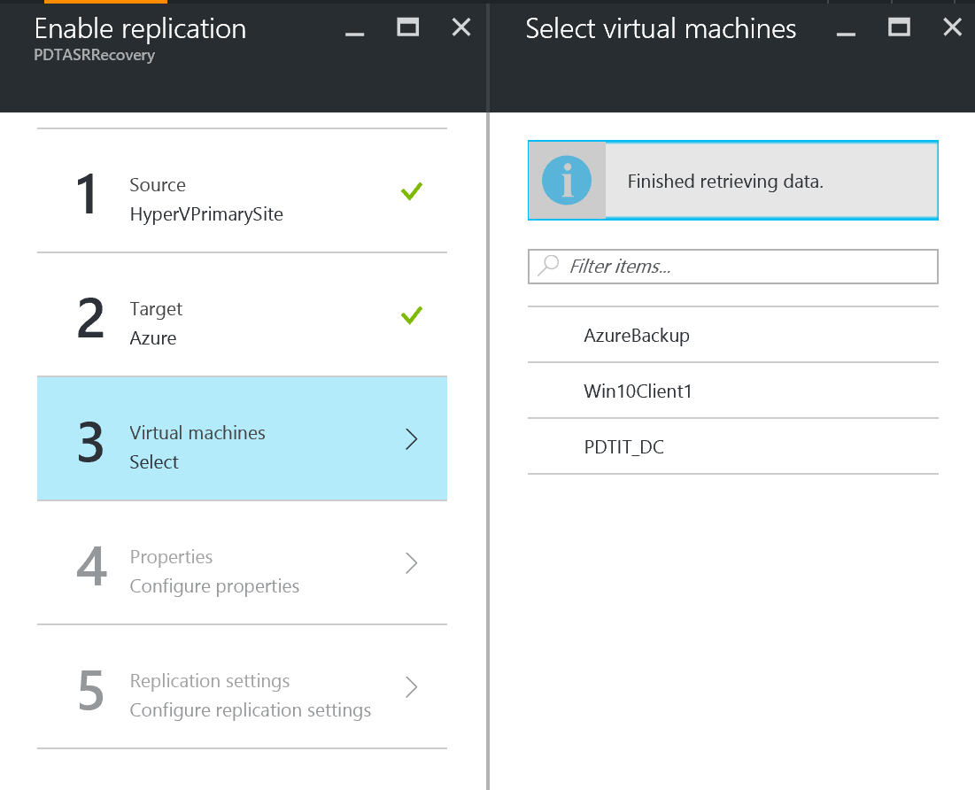
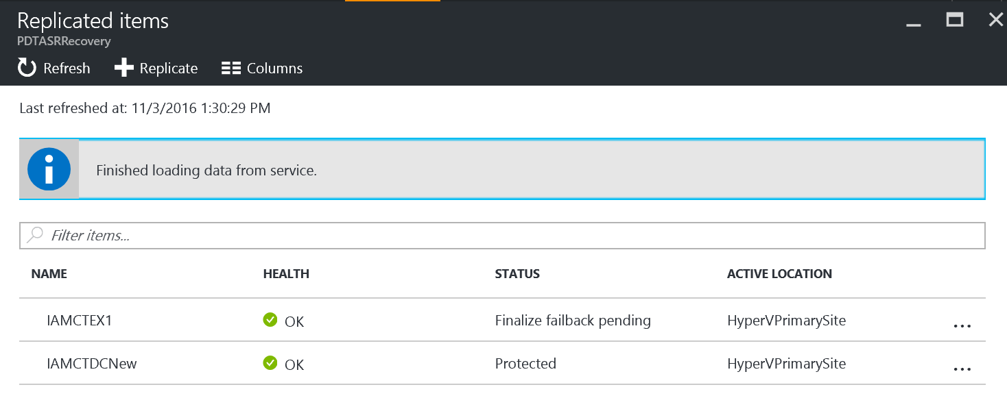
Step 6: Enable protection for VMs

Slide 40
Step 7: Test Deployment
Test Failover without Azure Network
Verifies a VM comes up in Azure, but it won’t be connected to any Azure Network
Test Failover with Azure Network
Verifies the entire replication comes up in Azure, making sure the VMs are connected to their specified Azure recovery network.
Requires configuration of a separate (isolated) Azure network
Verify Test Failover Process from “Jobs” tab

Slide 41
Step 7: Test Deployment Process
The following steps occur during the test process:
Prerequisites check for failover
Create test environment
Create test virtual machine
Preparing the virtual machine
Start the virtual machine
Complete testing
Clean up the test virtual machine
Clean up the test environment
Finalizing test failover
Full test on a typical Windows VM takes only 15min

Slide 42
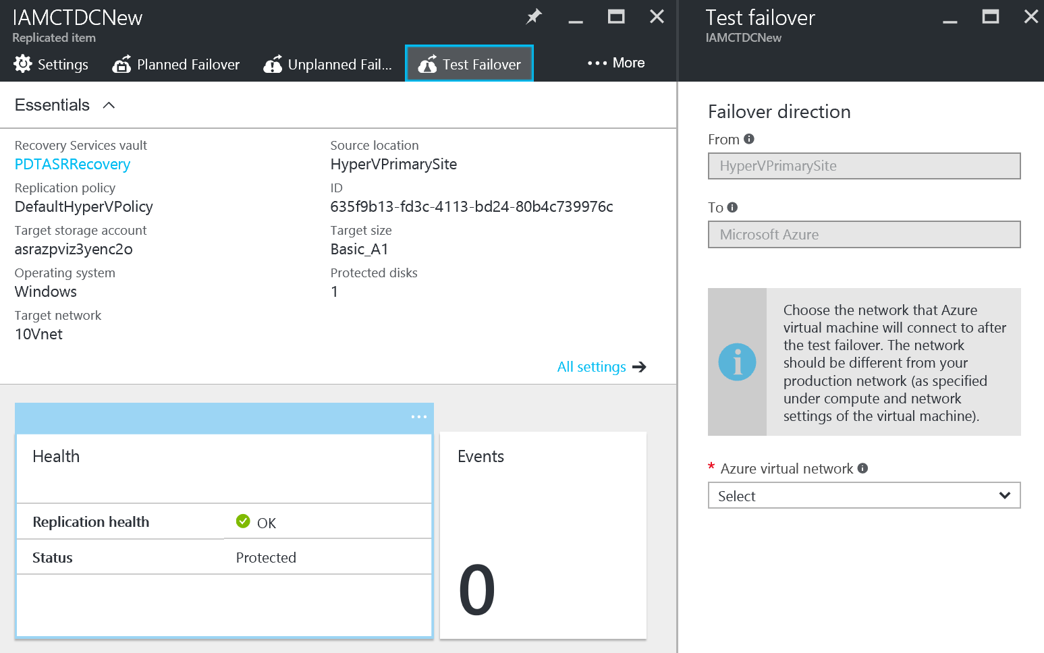
Step 7: Test Failover

Slide 43
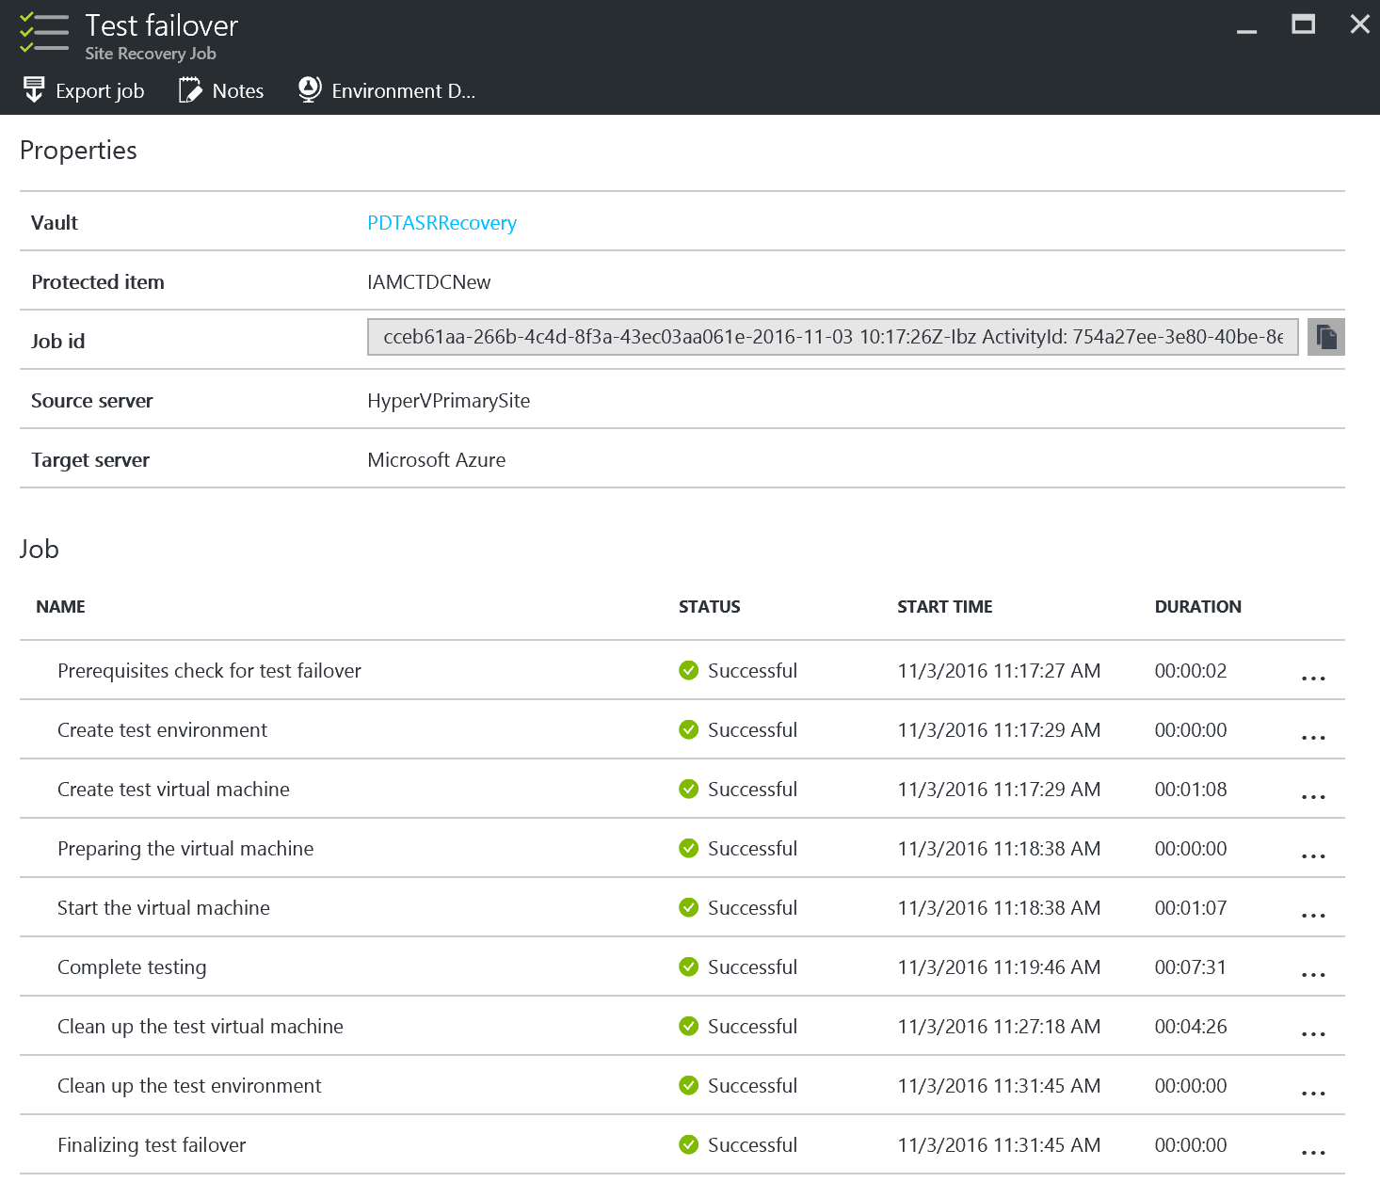
Step 7: Test Failover

Slide 44
ASR failover (test / unplanned / planned)

Slide 45
ASR for non-Hyper-V workloads (Vmware / Amazon AWS / AzClassic / Physical)
Notes:
Azure Virtual Machines lets you create and use virtual machines in the cloud. This is one of Azure’s Infrastructure as a Service (IaaS) features. The A virtual machine technology can be used in variety of ways.

Slide 46
ASR for non-Hyper-V workloads (VMware / AWS / Physical / AzClassic)
Configuration Step | Description
1. Configure ASR Vault | Create the ASR Security Vault configuration + download Vault registration Key
2. Prepare on-premises infrastructure | Download and install ASR Configuration Server / Process Server in Vmware/AWS/physical/AzClassic infra
3. Create Azure Storage Account | Create Azure Storage Account for ASR
4. Configure Cloud Protection | Add Configuration Server to Azure ASR
5. Map Networks | Map on-premises network to Azure VNets
6. Enable Protection for VMs | enable protection for VMs
7. Configure Recovery Plans | Configure Recovery Plans with detailed steps (scripts / automation)
8. Perform Test Failover | Run a test failover to verify Recovery Plans are complete
9. Perform DR simulation | Run through a full DR simulation (planned / unplanned failover)
10. Update DR documentation | Update DR documentation with observations

Slide 47
ASR failover (test / unplanned / planned)
Notes:
Open SSMS
Generate a credential for SQL Server to use to access blob storage
Backup database
Select URL
Select the credential
Set storage account and container
Show the back up in blob storage.

Slide 48
ASR Protection Plans
Notes:
Azure Virtual Machines lets you create and use virtual machines in the cloud. This is one of Azure’s Infrastructure as a Service (IaaS) features. The A virtual machine technology can be used in variety of ways.

Slide 49
Step 8: Fine-tune Protection Plans
Protection Plans = Grouped set of VMs/Actions
Actions = Customized PowerShell scripts
Examples: RDP Endpoints, DNS updates, File copy,…
Protection Plan Gallery or custom build

Slide 50
Demo: ASR Protection Plans
Notes:
Azure Virtual Machines lets you create and use virtual machines in the cloud. This is one of Azure’s Infrastructure as a Service (IaaS) features. The A virtual machine technology can be used in variety of ways.

Slide 51
Some Final Tips & Tricks

Slide 52
DR Project costing is complex
Azure Site Recovery licenses (monthly fee per VM)
Azure IAAS
For VMs created by ASR during Dev/Test, DR or Migration
For VMs continuously running in Azure e.g. AD, SQL Always-ON etc.
Storage
Network bandwidth and Site-to-Site VPN
SQL Always-ON
ExpressRoute
Workload license cost
With ASR for MSFT workloads no additional cost. For others check their licensing.

Slide 53


ASR as part of OMS – Operations Management Suite
Log analytics
Backup & Site Recovery
Automation
Security & Compliance
Effortless log collection
Integrated fast search and queries with custom dashboard
Integrated cloud backup
Seamless disaster recovery and workload migration
Hybrid runbook worker
Graphical workbook authoring and automation DSC
Malware assessment
Security posture and system update assessment
With OMS capabilities customers can…
Spot problems fast
Protect data & Applications easily
Automate tasks quick
Recognize threat early
extending System Center capabilities, as an all-in-one management solution!

Slide 54
ASR near-future updates
Notes:
Azure Virtual Machines lets you create and use virtual machines in the cloud. This is one of Azure’s Infrastructure as a Service (IaaS) features. The A virtual machine technology can be used in variety of ways.

Slide 55
Mobility Service Auto-deployment
ASR mobility agent provides a scripted install to automate the deployment to source machines
ASR mobility agent can be deployed from an SCCM package
Supports both Windows and Linux Server OS
https://docs.microsoft.com/en-us/azure/site-recovery/site-recovery-install-mobility-service-using-sccm

Slide 56
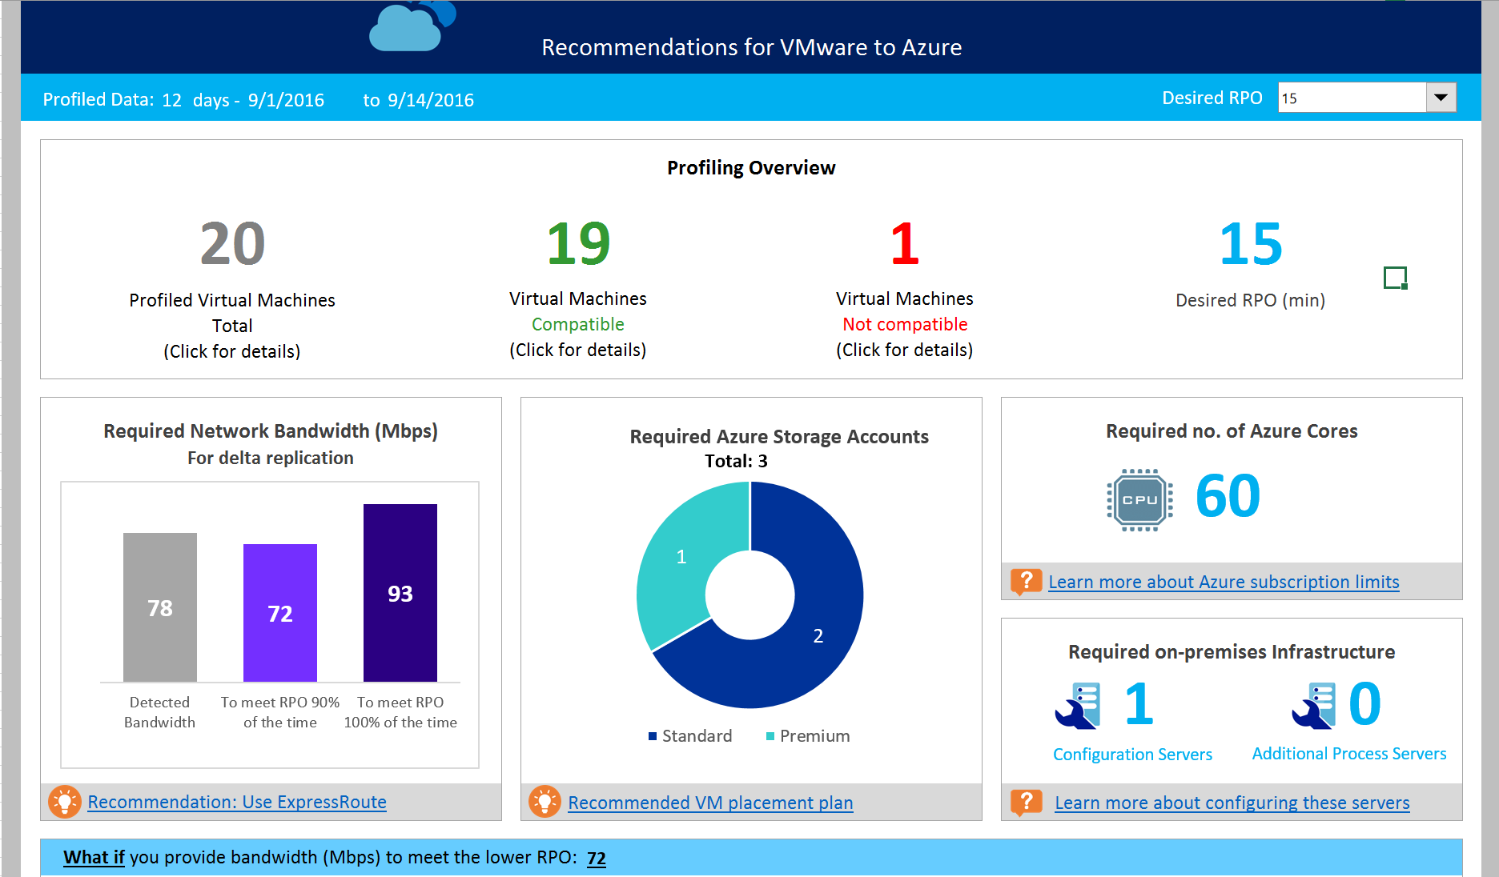
Updated Capacity Planner

Slide 57
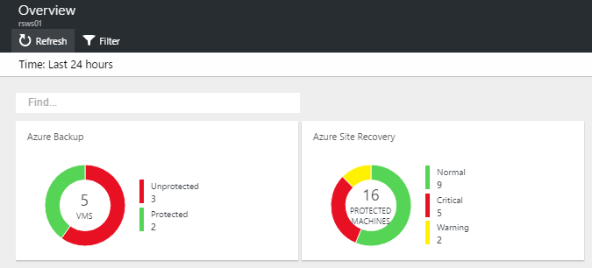
OMS integration for ASR-ARM
At present, OMS only recognizes Classic ASR in the Solution Pack dashboard
Currently private preview on ASR-ARM integration in OMS, based on ARM template

Slide 58
Azure to Azure
Currently Private Preview ongoing to test Azure-to-Azure ASR functionality
http://aka.ms/asr-a2a-pri-preview

Slide 59
Sample ARM Template for ASR (+OMS)
https://github.com/krnese/AzureDeploy/tree/master/OMS/MSOMS/BackupandRecoveryOMS

Slide 60
Q&A
pedete@Microsoft.com @pdtit

